Slide 1
Financial Board Training
Presented by: NONPROFIT PROGRAM OFFICE

Slide 2
Nonprofit Program Office
Kimberly Collins, NPPO Director
Allan Krehbiel, NPPO Auditor
Paula Floyd, NPPO Management Analyst

Slide 3
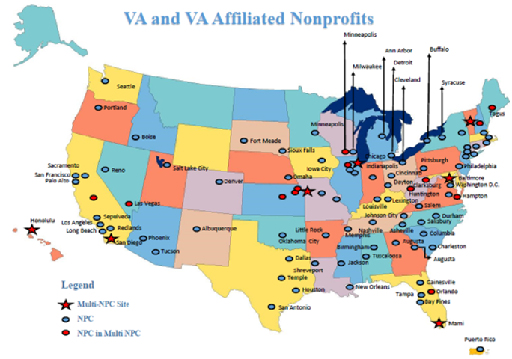

Slide 4
VA and the VA Affiliated Nonprofits – A Unique Public/Private Partnership
Currently, there are 81 VA Affiliated Nonprofit Research and Education Corporations (NPCs). Eight are Multi-NPCs, serving more than one medical center.
The NPCs were established in 1988 by Congress to support VA research and education with oversight by the Secretary.
NPCs are governed by boards of directors that must meet at least 4 times a year to provide leadership and oversight.
There are four directors required by law (statutory directors):
Medical Center Director
Chief of Staff
Associate Chief of Staff for Research
Associate Chief of Staff for Education

Slide 5
VA and the VA Affiliated Nonprofits – A Unique Public/Private Partnership
At least two Community Directors are required.
Each NPC employs or appoints the Executive Director who is charged with responsibility for the day-to-day management of the NPC.
The Medical Center Director must formally approve the Executive Director and non-statutory board members.

Slide 6
Revenues and Federal Funds
$275 Million in Revenues for FY 2018
A New Record Year!!
Governmental ……………..$182,551,000
Non-governmental……….....$88,505,000
Interest income…………….....$2,504,000
Other misc. ……………..………$972,000
Total………………………..$274,532,000
Sixty-six of the 81 NPCs receive Federal funds either as the prime recipient, as a reimbursement, or as a sub-award.
The decision on whether the academic affiliate or the NPC receives the prime award is made at the local level.
The small NPCs would not have the resources necessary to administer Federal awards due to the time between funds expended and funds reimbursed.

Slide 7
NPPO Responsibilities
Triennial on-site audits.
Monitoring NPC annual reports, IRS Form 990 Information Returns, and reports of independent outside auditors where applicable.
Following-up on material weaknesses and other audit action items reported by the independent outside auditors.
Preparing the mandatory NPC Annual Report to Congress.

Slide 8
NPPO Responsibilities
Implementing VHA Handbook 1200.17.
Performing on-site field investigations and follow-up reviews.
Educating board members and NPC key employees.
Consulting as requested.
All instances indicating fraud or serious waste and abuse are immediately referred to the VA OIG.

Slide 9
NPPO is dedicated to continuous improvement and to maintaining the excellent previous VA NCOD survey results which included a 99.2% score for “professionalism” and 96.6% for maintaining a collegial atmosphere in the course of the audits.
NPPO strives for 100%

Slide 10
Deputy Under Secretary for Health for Discovery, Education and Affiliate Networks (10X)
VHA Chief
Financial Officer
Office of Research
and Development
General Counsel (02) or designee;
Deputy Under Secretary for Health for Operations and Management (10N);
Chief or Deputy Chief Research and Development Officer (10X2);
Chief Academic Affiliations Officer (10X1) or designee;
Chief Financial Officer for VHA (10A3) or designee;
Executive Director or Deputy Director, Office of Research Oversight (10R);
Member of the Field Research Advisory Council, Office of Research and Development; and
Field Representative, Designated Education Officer
Field Representative, Associate Chief of Staff for Research
Nonprofit Program Office
Nonprofit Research Corporations

Slide 11
PURPOSE OF NPCS
To enhance VA Research and education

Slide 12
Financial Responsibilities of the Board
Understand Financial Literacy
Oversee Financial Planning
Ensure the Protection of Assets
Provide Risk Management
Attend the Meetings and Ask Questions!

Slide 13
Financial Literacy
Fiduciary Responsibilities
Recruitment of Member with Financial Acumen
Every Member should be able to read the Financial Statements
Ensure Accuracy and Efficiency of Management

Slide 14
Financial Planning
Oversee Financial Management
Approve Annual Administrative Budget
Fiscal Policies and Procedures

Slide 15
Ensure Protection of Assets
Cash
Investment Accounts
Segregation of Duties

Slide 16
Provide Risk Management
External Audits
Three-to-five years consider changes in firm or lead CPA
Meet with the auditors at least annually without the NPC staff present
Anticipate Financial Problems

